Slide 1



Object-Oriented Programming
Values and References
SoftUni Team
Technical Trainers
Software University
http://softuni.bg

Slide 2

Table of Contents
How are different data types stored, initially, in the memory?
Value type
Reference type
What are Structs?
Memory allocation.

Slide 3
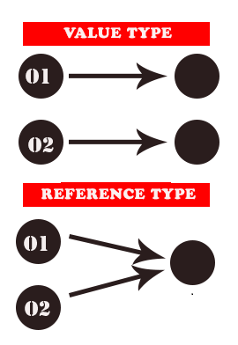
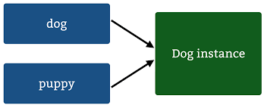
Memory Storage of Different Data Types
A value type directly stores a value, whereas a reference type only stores a reference to an actual value

Slide 4

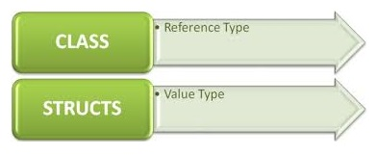
What are Structs?
The keyword struct is used to create user-defined types that consist of small groups of related fields
value types—as opposed to classes, which are reference types
suitable for representing lightweight objects

Slide 5
What are Structs?
Often in programs we have small classes that serve as collections of related variables stored in memory. These types often make ideal structs
Struct creation
public struct Point
{
public double X, Y;
}
public class Program
{
public static void Main(string[] args)
{
Point simplePoint;
simplePoint.X = 10;
simplePoint.Y = 20;
}
}
Struct members
Struct instance
Initialization of struct fields

Slide 6

Memory Allocation

Slide 7

Memory Allocation
After you enter a value or text into a cell, you can modify it in a number of ways
A good way to understand how value types differ from reference types is to visualize how each of them is represented in memory

Slide 8
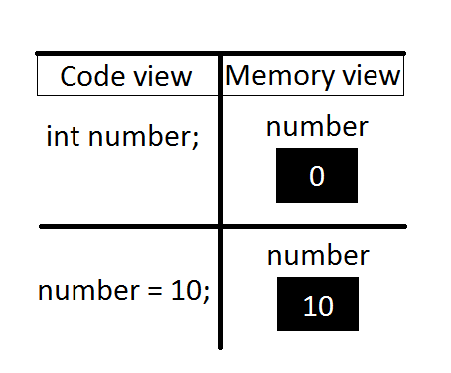
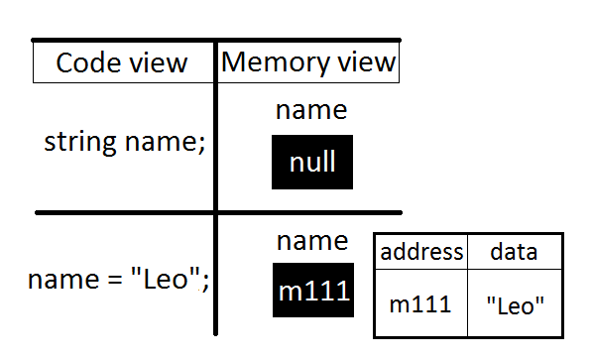
Memory Allocation
This example shows how values are stored in memory, when they are declared and after that when they are initialized

Slide 9
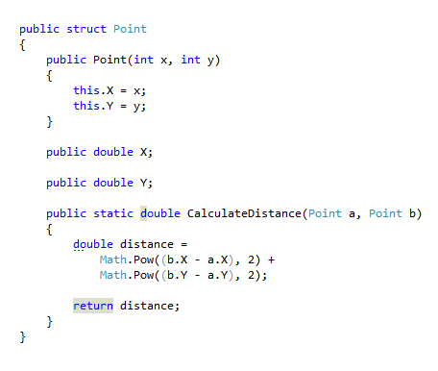
Exercise in class

Slide 10








Questions
https://softuni.bg/courses/javascript-applications/

